Slide 1


Super Store Sales Analysis
24/10/2024
By: Group 3
Training Co.: I Learn
Instructor: Eng Osama Adel

Slide 2


Team
Project Info
Project Issues
Processing
Comprehensive Sales Analysis and Forecasting: A Data-Driven Approach using SQL, Python , Power Bi, and Tableau

Slide 3





Home
MEET OUR TEAM
Basem Elbehiri
Ahmed Masoud
Ashraf Aboalyazid
Ahmed Tawfek
Mohamed Hagag

Slide 4

Super Store Sales
Home
This project analyzes sales data from a major U.S. retail store to uncover insights into customer behavior, product performance, and shipping strategies. By leveraging detailed order information, the analysis aims to identify key trends that drive business performance and improve decision-making.
Key Objectives:
Sales Performance: Analyze product-level sales to identify top-performing items and areas needing improvement.
Customer Behavior: Understand purchasing patterns based on customer segments and geographic locations.
Shipping Impact: Evaluate how shipping methods affect customer satisfaction and sales outcomes.
Sales Trends: Identify high-sales periods and seasonal patterns.
Tools and Methods:
Statistical Analysis: Explore correlations between variables like category and shipping.
Data Visualization: Use charts and graphs for clear, actionable insights.
Impact:
The project provides actionable insights to optimize marketing strategies, improve customer satisfaction, and increase sales, ultimately enhancing the store’s competitiveness in the retail market.
General information about the project.

Slide 5

Super Store Sales
Home
After importing the data into SQL, the following issues were discovered:
1- Missing data in columns such as Order Date and Ship Date was identified due to data type issues, and these columns were converted to the Date type.
2- We separated the IDs from OrderID, CustomerID, and ProductID to improve readability and enhance data organization.
3-We renamed the columns to remove spaces, ensuring smoother and faster code writing in SQL without any issues or delays.
4- There were some missing values in the Postal Code column, totaling 10 entries. Based on our assessment, this column is not significant for the analysis, so we decided to exclude it from the analytical processes.
5- We performed data cleansing and found no other issues with the data.
Important Note: We discovered that the Sales column lacks any references, such as sold quantities, selling prices for each product, shipping costs, and product costs. Having this data would be very useful!
Identified Issues in the Data:

Slide 6

Home
1
Data Preprocessing
2
Analysis Questions Phase
Steps of Data Preparation
Forecasting Questions Phase
3
Visualization Dashboard
4

Slide 7




Home
Data Cleaning
Data Modeling
Data Preparation for Analysis
Split raw data into logical tables (customers, products, orders, sales).
Define relationships between tables (fact and dimension tables).
Establish primary and foreign keys.
Identify and handle missing values.
Remove duplicates and inconsistent entries.
Standardize and format column names.
Ensure correct data types (e.g., converting dates, numbers).
Ensure referential integrity between tables.
Create a unified dataset for analysis.
Export the cleaned dataset for future processing.

Slide 8

3
check for incorrect values
2
SELECT OrderID, Customer_ID, Product_ID
FROM supersales
WHERE ISNUMERIC(OrderID) = 0
OR ISNUMERIC(Customer_ID) = 0
OR ISNUMERIC(Product_ID) = 0;
Check standard deviation
select max(amount)
from Sales
select min(amount)
from Sales
SELECT *
FROM sales
WHERE amount < 0.444 OR amount > 22638.48;
1
Check Null
select count(*) as OrderDate_Total_nulls
from ['Superstore Sales Dataset$']
where [Order Date] is null
select count(*) as OrderID_Total_nulls
from ['Superstore Sales Dataset$']
where [Order ID] is null
select count(*)as ShipDate_Total_nulls
from ['Superstore Sales Dataset$']
where [Ship Date] is null

Slide 9

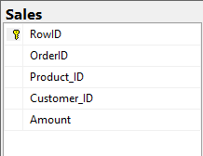
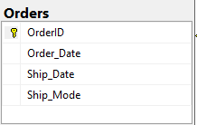
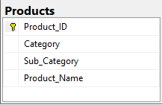
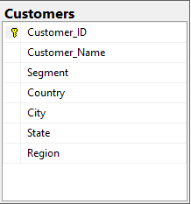

Slide 10

Home
3
1
2
Determine Data Analysis Questions
Tools Used
Deliverables
SQL: For data extraction and querying.
Python (Pandas, Matplotlib): For statistical analysis and data visualization
A comprehensive set of analysis questions that can be answered using the dataset.
Examples of Analysis Questions:
What is the impact of product categories on sales performance?
How do geographical regions affect sales volume?
Which product categories generate the highest revenue?
What are the monthly or seasonal sales trends?

Slide 11


Home
Questions Tools
SQL
Python

Slide 12
Back
---تحليل العملاء الذين يساهمون بأعلى نسبة من المبيعات
SELECT top 20 c.customer_name, count(s.orderid)as Total_Invoice,SUM(s.amount) AS total_sales
FROM Customers c join sales s
on c.Customer_ID=s.customer_id
join Orders o on o.orderid=s.orderid
GROUP BY customer_name
ORDER BY Total_Invoice DESC;
---ما هي فئات المنتجات التي تحقق أعلى طلبيات، وكيف يتم توزيع الطلبات بين مختلف الفئات الفرعية؟
select p.category ,p.sub_category, count(o.orderID) as Total_Orders,SUM(s.amount) as Total_Amount
from Products p join Sales s
on p.Product_ID = s.Product_ID
join Orders o on o.OrderID=s.OrderID
group by p.category,p.sub_category
order by Total_Orders desc
----- اعلي المناطق طلبا
select c.region, State,count(o.orderID) as Total_Orders, sum(s.amount)as Invoice_Amount
from Customers c join Sales s
on c.Customer_ID = s.Customer_ID
join Orders o on o.OrderID=s.OrderID
group by c.region,State
order by Invoice_amount desc
---- تحليل معدل المبيعات حسب منطقة الشحن أو فئة الشحن
SELECT o.ship_mode, count(o.orderID) AS Total_Invoice,sum(s.amount) as total_amount
FROM Orders o join sales s
on o.orderid=s.orderid
GROUP BY ship_mode
ORDER BY Total_Invoice DESC;

Slide 13
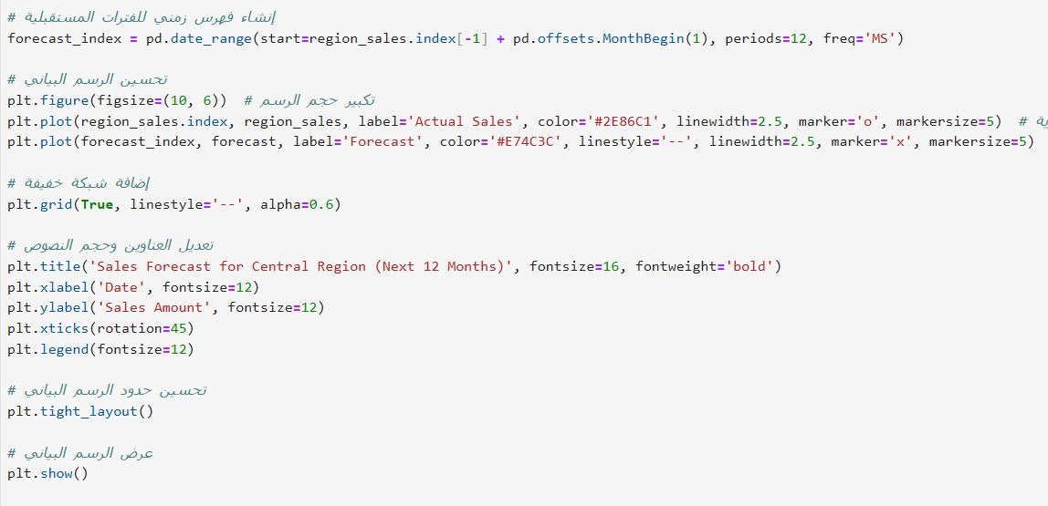
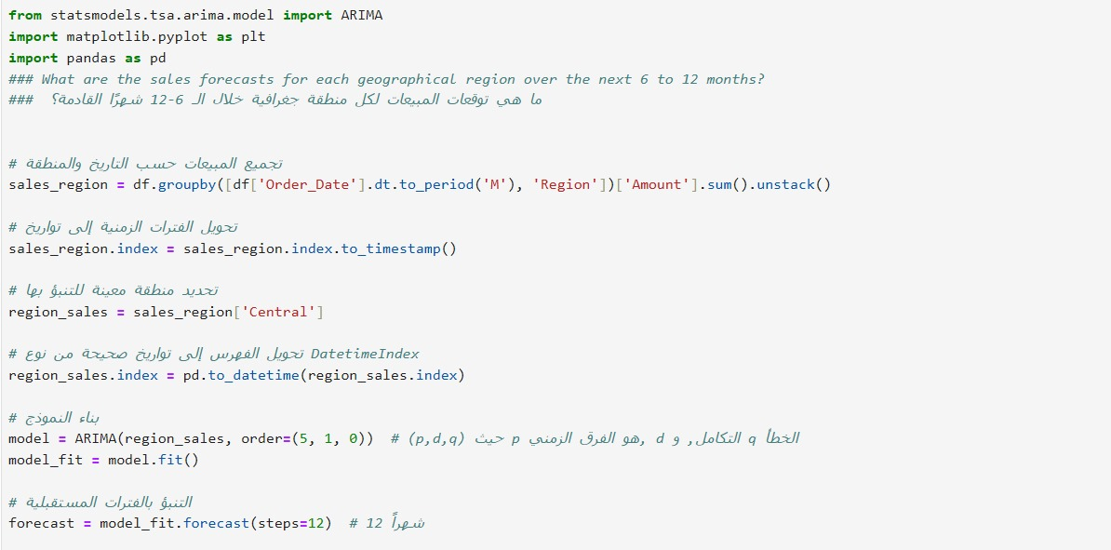
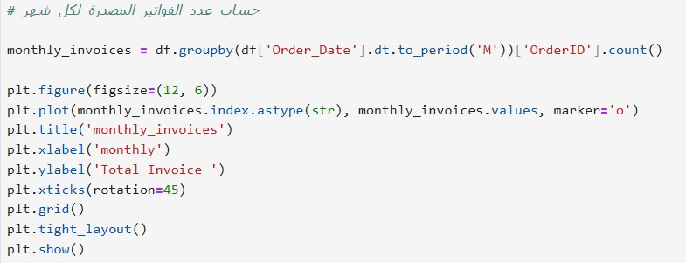
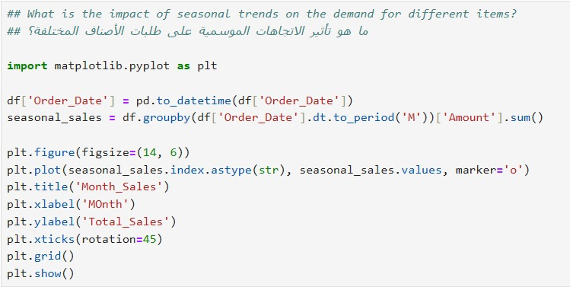
Back

Slide 14
Home
Key Forecasting Questions
Tools Used : Python
Forecasting Questions Phase
Deliverables
Visual Examples

Slide 15


What are the projected sales for the upcoming months?
Which product categories are expected to grow in the future?
How will regional demand shifts affect overall sales?
Can we predict seasonal demand spikes?

Slide 16

scikit-learn: For building forecasting models.
Pandas: Data manipulation and trend analysis.
Python Tools
Matplotlib: Visualizing forecasting results.

Slide 17

Forecast Visualization: Sales trend charts.
Predictive Insights: Insights on future sales, demand patterns, and category performance.
Deliverables
Reports: Summarized findings for stakeholders.

Slide 18
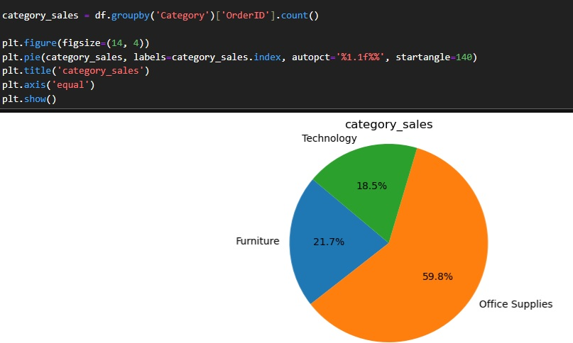
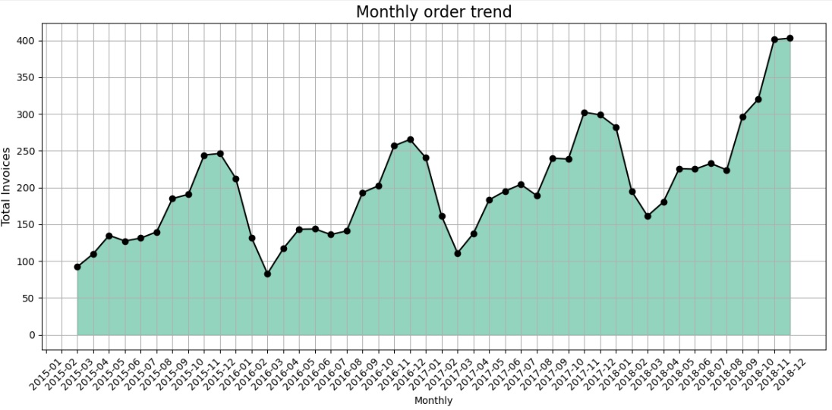
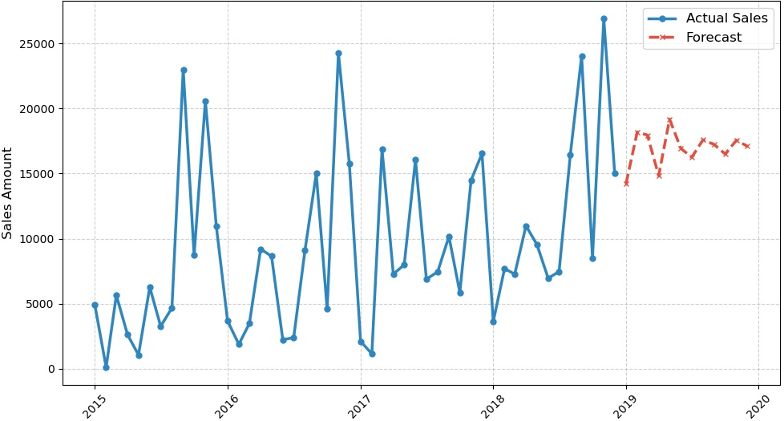
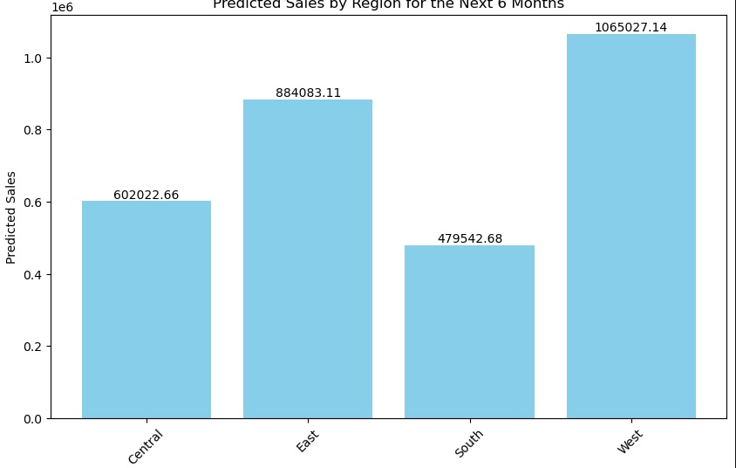
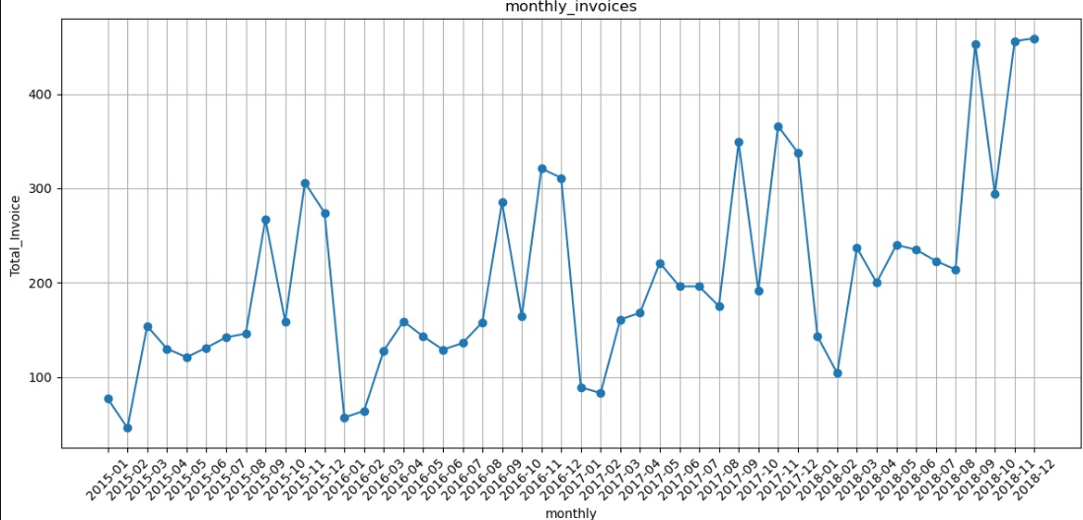

Slide 19

Home

Slide 20
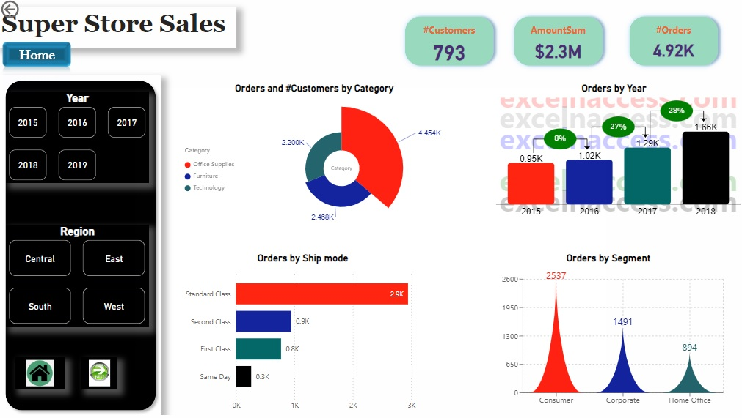

Slide 21
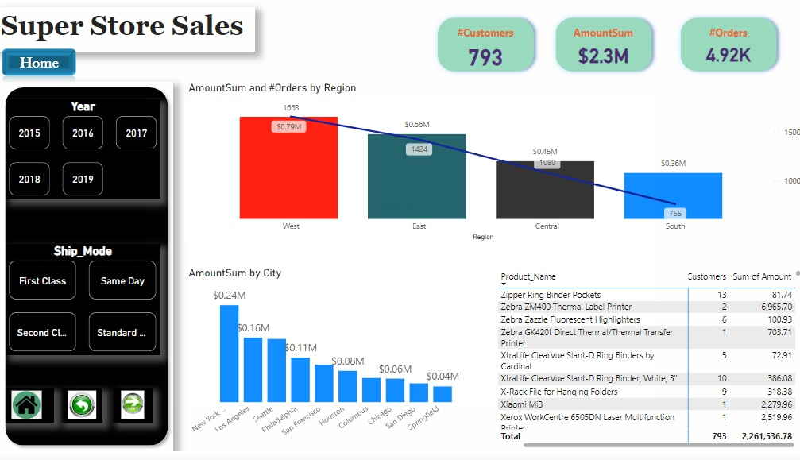

Slide 22
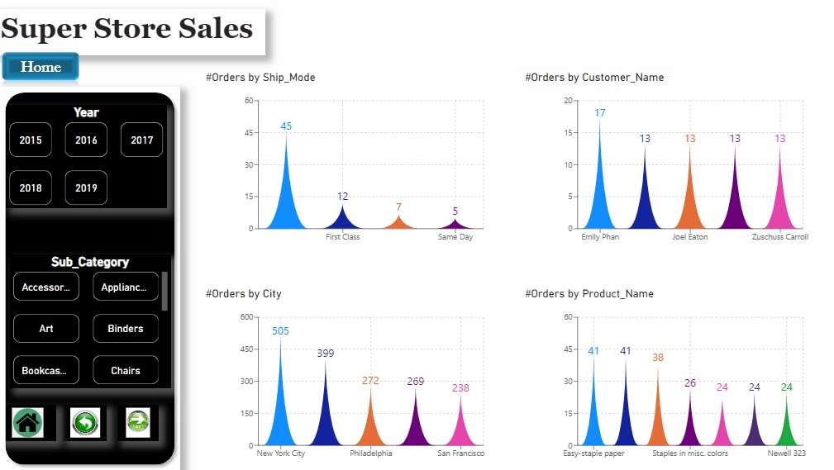

Slide 23
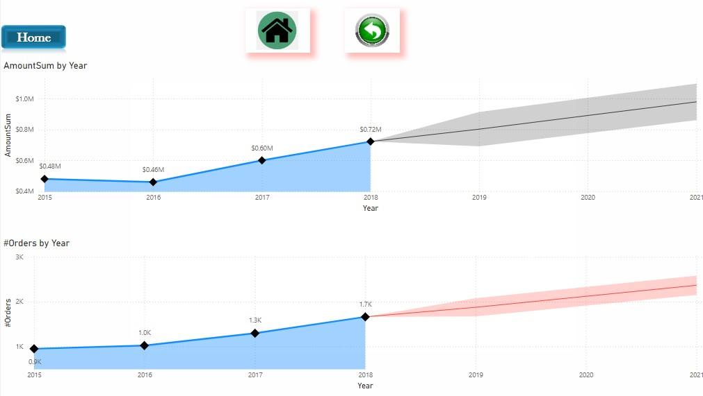

Slide 24

Insights
Rarely Ordered Products
Observation: Certain products have been ordered only once in the last four years.
Implication: This signals potential opportunities for effective promotion or a reevaluation of product availability.
Seasonal Trends in Orders
Observation: Orders spike significantly in November and December, with a drop in January and February.
Implication: Indicates holiday-related purchasing patterns, necessitating tailored marketing strategies during these months.
Top Products and Customers
Observation:
The top 10 ordered products do not include the highest revenue-generating items, suggesting a disconnect between popularity and profitability.
Top customers show significant variation in order volume and total spending, reflecting a diverse purchasing behavior.
High Spend vs. Frequency
Observation: The highest spender made only five orders, while the most frequent customer made 17 orders.
Implication: There are distinct customer segments; some prioritize high-value purchases, while others favor frequency over spend.
Dominant Product Categories and Segments
Observation: Most ordered items fall within the office supplies category and are favored by the consumer segment.
Implication: Opportunity exists to enhance product offerings in this category.
Shipping Preferences
Observation: Standard shipping is the most preferred mode.
Implication: This preference should inform logistics and shipping strategies.
Geographic Insights
Observation: New York City leads in revenue and number of orders, while western regions have higher order volumes compared to other regions.
Implication: Marketing and logistics strategies should cater to these geographic preferences.

Slide 25
Recommendations
Enhance Promotion of Underperforming Products: Investigate and promote rarely ordered products to boost their visibility and assess their viability in the market.
Leverage Seasonal Demand: Develop targeted marketing campaigns and inventory strategies to capitalize on increased purchasing activity during the holiday season.
Maximize Product Profitability: Evaluate the profitability of the most ordered products and explore opportunities to replace or upsell with higher-margin alternatives.
Tailor Customer Engagement Strategies: Create personalized marketing approaches for different customer segments to encourage both high-value transactions and repeat purchases.
Focus on Best-Selling Items: Highlight and consistently stock the most sold products to meet demand and enhance marketing efforts around these items.
Optimize Office Supplies Offerings: Expand and refine the product range within the office supplies category to better serve the consumer segment.
Standardize Shipping Options: Maintain standard shipping as the primary option to align with customer preferences and streamline logistics.
Target Geographic Marketing: Adapt marketing and logistics strategies to focus on high-demand areas, particularly New York City and the western regions, to maximize revenue potential.

Slide 26
Thank you for your attendance!
We appreciate your time and interest in our project. We hope you found the information useful and that you gained a clear understanding of what we have accomplished. We are excited about the next steps and look forward to any questions or comments you may have.

